Slide 1
Hospital Management System
DBMS Minor Project
Course Code: UCS4001
Academic Session: 2025 – 2026
Submitted By: Ayush Kumar Singh
Aman Kumar Singh
Hardik Tomar
Keshav Kumar

Slide 2

Introduction
Hospital Management System is a database-based system
It manages daily hospital activities
It handles:
Patient records
Doctor information
Appointments
Billing

Slide 3
Objective of Project
Reduce data redundancy
Manage patient and doctor records
Generate billing and reports
Understand database normalization

Slide 4
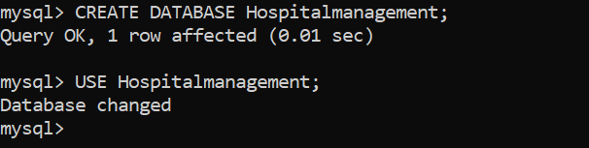
Database Used
Database Name: Hospitalmanagement
Created using MySQL
SQL queries are used for operations

Slide 5

Tables in Database
Main Tables
Patient
Doctor
Staff
Room
Appointment
Admission
Medicine
Prescription
Billing

Slide 6

1.Patient Table
Definition: Stores patient information
Fields:
PatientID (Primary Key)
Name
Age
Gender
Phone
Address

Slide 7
Patient Table
CREATE TABLE Patient (
PatientID INT PRIMARY KEY,
Name VARCHAR(50) NOT NULL,
Age INT,
Gender VARCHAR(10),
Phone VARCHAR(15) UNIQUE,
Address VARCHAR(100)
);
Explanation
PatientID INT PRIMARY KEY → Unique ID for each patient
Name VARCHAR(50) NOT NULL → Name cannot be empty
Age INT → Stores patient age
Gender VARCHAR(10) → Male/Female/Other
Phone VARCHAR(15) UNIQUE → No duplicate phone numbers allowed
Address VARCHAR(100) → Patient address

Slide 8
PatientID | Name | Age | Gender | Phone | Address
1 | Rahul | 25 | Male | 9876543210 | Noida
2 | Amit | 30 | Male | 9876543211 | Delhi
3 | Neha | 22 | Female | 9876543212 | Greater Noida
4 | Pooja | 28 | Female | 9876543213 | Ghaziabad
5 | Ravi | 35 | Male | 9876543214 | Noida
6 | Sneha | 26 | Female | 9876543215 | Delhi
7 | Karan | 31 | Male | 9876543216 | Meerut
8 | Priya | 24 | Female | 9876543217 | Agra
9 | Ankit | 29 | Male | 9876543218 | Aligarh
10 | Riya | 23 | Female | 9876543219 | Mathura
11 | Vikas | 40 | Male | 9876543220 | Delhi
12 | Komal | 21 | Female | 9876543221 | Noida
13 | Sahil | 34 | Male | 9876543222 | Faridabad
14 | Nisha | 27 | Female | 9876543223 | Delhi
15 | Deepak | 38 | Male | 9876543224 | Noida
16 | Meena | 32 | Female | 9876543225 | Ghaziabad
17 | Arjun | 33 | Male | 9876543226 | Meerut
18 | Tina | 25 | Female | 9876543227 | Agra
19 | Rohit | 36 | Male | 9876543228 | Delhi
20 | Simran | 28 | Female | 9876543229 | Noida

Slide 9

2.Doctor Table
Definition:Stores doctor details
Fields:
DoctorID (Primary Key)
Name
Specialization
Phone

Slide 10
Doctor Table
Explanation
DoctorID INT PRIMARY KEY → Unique ID for each doctor
Name VARCHAR(50) NOT NULL → Doctor name (cannot be empty)
Specialization VARCHAR(50) → Field like Cardiologist, Dentist, etc.
Phone VARCHAR(15) → Contact number
CREATE TABLE Doctor (
DoctorID INT PRIMARY KEY,
Name VARCHAR(50) NOT NULL,
Specialization VARCHAR(50),
Phone VARCHAR(15)
);

Slide 11
DoctorID | Name | Specialization | Phone
101 | Dr Sharma | Cardiologist | 9811111111
102 | Dr Gupta | Neurologist | 9822222222
103 | Dr Verma | Orthopedic | 9833333333
104 | Dr Khan | Dentist | 9844444444
105 | Dr Singh | Pediatrician | 9855555555
106 | Dr Mehta | Dermatologist | 9866666666
107 | Dr Jain | ENT | 9877777777
108 | Dr Das | Physician | 9888888888
109 | Dr Roy | Gynecologist | 9899999999
110 | Dr Patel | Surgeon | 9800000000

Slide 12
3.Staff Table
Description: Stores hospital staff details
Attributes:
StaffID (Primary Key)
Name
Role
Phone

Slide 13
Staff Table
Explanation:
StaffID → Unique ID for each staff member
Name → Name of staff
Role → Job role (Nurse, Receptionist, Technician, etc.)
Phone → Contact number of staff
CREATE TABLE Staff (
StaffID INT PRIMARY KEY,
Name VARCHAR(50),
Role VARCHAR(30),
Phone VARCHAR(15)
);

Slide 14
StaffID | Name | Role | Phone
201 | Asha | Nurse | 9000000001
202 | Rita | Receptionist | 9000000002
203 | Mohan | Ward Boy | 9000000003
204 | Suresh | Cleaner | 9000000004
205 | Kavita | Nurse | 9000000005
206 | Ajay | Technician | 9000000006
207 | Reena | Nurse | 9000000007
208 | Pankaj | Pharmacist | 9000000008
209 | Sunita | Nurse | 9000000009
210 | Raj | Security | 9000000010

Slide 15

4.Room Table
Definition:Stores hospital room details
Fields:
RoomID
RoomType
Status
Charges

Slide 16
Room Table
Explanation:
RoomID INT PRIMARY KEY → Unique room number
RoomType VARCHAR(30) → Type (General, ICU, Private, etc.)
Status VARCHAR(20) → Available / Occupied
Charges DECIMAL(10,2) → Cost per day
CREATE TABLE Room (
RoomID INT PRIMARY KEY,
RoomType VARCHAR(30),
Status VARCHAR(20),
Charges DECIMAL(10,2)
);

Slide 17
RoomID | RoomType | Status | Charges
301 | General | Available | 1500.00
302 | ICU | Occupied | 5000.00
303 | Private | Available | 3000.00
304 | General | Available | 1500.00
305 | ICU | Occupied | 5000.00
306 | Private | Available | 3000.00
307 | General | Occupied | 1500.00
308 | Private | Available | 3000.00
309 | ICU | Available | 5000.00
310 | General | Available | 1500.00

Slide 18

5.Appointment Table
Definition:Stores appointment details
Fields:
AppointmentID
PatientID (Foreign Key)
DoctorID (Foreign Key)
Date
Time

Slide 19
Appointment Table
Explanation:
AppointmentID → Unique ID for each appointment
PatientID → Links to Patient table
DoctorID → Links to Doctor table
Date → Appointment date
Time → Appointment time
FOREIGN KEY → Maintains relationship between tables
CREATE TABLE Appointment (
AppointmentID INT PRIMARY KEY,
PatientID INT,
DoctorID INT,
Date DATE,
Time TIME,
FOREIGN KEY (PatientID) REFERENCES Patient(PatientID),
FOREIGN KEY (DoctorID) REFERENCES Doctor(DoctorID)
);

Slide 20
AppointmentID | PatientID | DoctorID | Date | Time
501 | 1 | 101 | 2026-02-25 | 10:30:00
502 | 2 | 102 | 2026-02-26 | 11:00:00
503 | 3 | 103 | 2026-02-27 | 09:45:00
504 | 4 | 104 | 2026-02-25 | 12:15:00
505 | 5 | 105 | 2026-02-26 | 02:30:00
506 | 6 | 106 | 2026-02-27 | 03:00:00
507 | 7 | 107 | 2026-02-25 | 04:15:00
508 | 8 | 108 | 2026-02-26 | 05:00:00
509 | 9 | 109 | 2026-02-27 | 10:15:00
510 | 10 | 110 | 2026-02-25 | 11:45:00

Slide 21

6.Admission Table
Description: Stores patient admission details
Attributes:
AdmissionID (Primary Key)
PatientID (Foreign Key)
RoomID (Foreign Key)
AdmitDate
DischargeDate

Slide 22
Admission Table
Explanation:
AdmissionID → Unique admission number
PatientID → Links to Patient table
RoomID → Links to Room table
AdmitDate → Date when patient is admitted
DischargeDate → Date when patient is discharged
CREATE TABLE Admission (
AdmissionID INT PRIMARY KEY,
PatientID INT,
RoomID INT,
AdmitDate DATE,
DischargeDate DATE,
FOREIGN KEY (PatientID) REFERENCES Patient(PatientID),
FOREIGN KEY (RoomID) REFERENCES Room(RoomID)
);

Slide 23
AdmissionID | PatientID | RoomID | AdmitDate | DischargeDate
601 | 1 | 302 | 2026-02-20 | 2026-02-23
602 | 2 | 305 | 2026-02-21 | 2026-02-24
603 | 3 | 307 | 2026-02-22 | 2026-02-25
604 | 4 | 301 | 2026-02-23 | NULL
605 | 5 | 303 | 2026-02-24 | NULL
606 | 6 | 304 | 2026-02-25 | NULL
607 | 7 | 306 | 2026-02-21 | 2026-02-26
608 | 8 | 308 | 2026-02-22 | NULL
609 | 9 | 309 | 2026-02-23 | NULL
610 | 10 | 310 | 2026-02-24 | NULL

Slide 24

7.Medicine Table
Description: Stores medicine details
Attributes:
MedicineID (Primary Key)
Name
Price
Stock

Slide 25
Medicine Table
Explanation:
MedicineID → Unique ID for each medicine
Name → Medicine name
Price → Cost of medicine
Stock → Available quantity in inventory
CREATE TABLE Medicine (
MedicineID INT PRIMARY KEY,
Name VARCHAR(50),
Price DECIMAL(10,2),
Stock INT
);

Slide 26
MedicineID | Name | Price | Stock
401 | Paracetamol | 20.00 | 100
402 | Ibuprofen | 30.00 | 80
403 | Amoxicillin | 50.00 | 60
404 | Cetirizine | 15.00 | 120
405 | Azithromycin | 70.00 | 40
406 | Metformin | 25.00 | 90
407 | Aspirin | 10.00 | 150
408 | Insulin | 120.00 | 30
409 | Omeprazole | 35.00 | 75
410 | Dolo | 25.00 | 110

Slide 27

8.Prescription Table
Description: Stores prescription details
Attributes:
PrescriptionID (Primary Key)
PatientID (Foreign Key)
DoctorID (Foreign Key)
MedicineID (Foreign Key)
Quantity
Date

Slide 28
Prescription Table
Explanation:
PrescriptionID → Unique prescription number
PatientID → Links to Patient table
DoctorID → Links to Doctor table
MedicineID → Links to Medicine table
Quantity → Number of medicines prescribed
Date → Date of prescription
CREATE TABLE Prescription (
PrescriptionID INT PRIMARY KEY,
PatientID INT,
DoctorID INT,
MedicineID INT,
Quantity INT,
Date DATE,
FOREIGN KEY (PatientID) REFERENCES Patient(PatientID),
FOREIGN KEY (DoctorID) REFERENCES Doctor(DoctorID),
FOREIGN KEY (MedicineID) REFERENCES Medicine(MedicineID)
);

Slide 29
PrescriptionID | PatientID | DoctorID | MedicineID | Quantity | Date
701 | 1 | 101 | 401 | 2 | 2026-02-25
702 | 2 | 102 | 402 | 1 | 2026-02-26
703 | 3 | 103 | 403 | 3 | 2026-02-27
704 | 4 | 104 | 404 | 1 | 2026-02-25
705 | 5 | 105 | 405 | 2 | 2026-02-26
706 | 6 | 106 | 406 | 2 | 2026-02-27
707 | 7 | 107 | 407 | 1 | 2026-02-25
708 | 8 | 108 | 408 | 1 | 2026-02-26
709 | 9 | 109 | 409 | 2 | 2026-02-27
710 | 10 | 110 | 410 | 3 | 2026-02-25

Slide 30

9.Billing Table
Definition:Stores billing and payment details
Fields:
BillID
PatientID
Amount
PaymentStatus
BillDate

Slide 31
Billing Table
Explanation:
BillID → Unique bill number
PatientID → Links to Patient table
Amount → Total bill amount
PaymentStatus → Paid / Unpaid / Pending
BillDate → Date of billing
CREATE TABLE Billing (
BillID INT PRIMARY KEY,
PatientID INT,
Amount DECIMAL(10,2),
PaymentStatus VARCHAR(20),
BillDate DATE,
FOREIGN KEY (PatientID) REFERENCES Patient(PatientID)
);

Slide 32
BillID | PatientID | Amount | PaymentStatus | BillDate
801 | 1 | 2500.00 | Paid | 2026-02-25
802 | 2 | 3200.00 | Unpaid | 2026-02-26
803 | 3 | 4500.00 | Paid | 2026-02-27
804 | 4 | 1500.00 | Paid | 2026-02-25
805 | 5 | 3000.00 | Unpaid | 2026-02-26
806 | 6 | 5000.00 | Paid | 2026-02-27
807 | 7 | 2000.00 | Paid | 2026-02-25
808 | 8 | 3500.00 | Unpaid | 2026-02-26
809 | 9 | 4200.00 | Paid | 2026-02-27
810 | 10 | 2800.00 | Paid | 2026-02-25

Slide 33
Entity-Relationship Diagram (ERD)

Slide 34
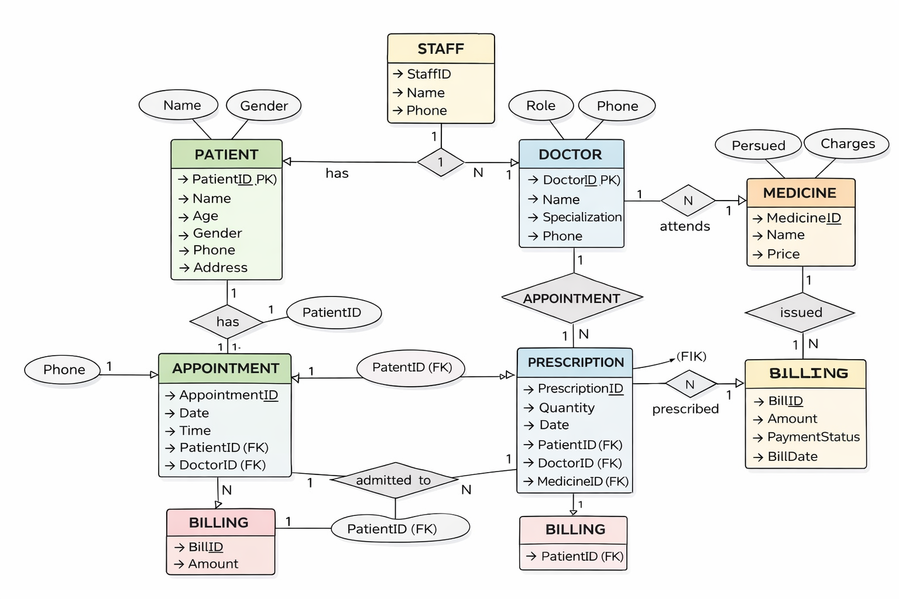

Slide 35

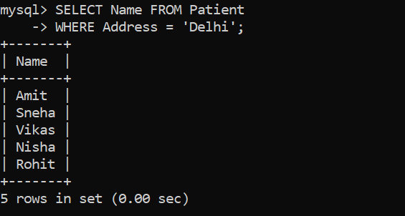
SQL Queries
1.Write an SQL query to display the names of patients who belong to city "Delhi".
Ans:
SELECT Name FROM Patient WHERE Address = 'Delhi';

Slide 36
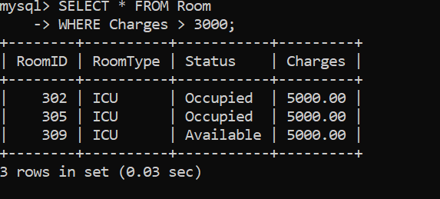

2.Write an SQL query to display all rooms with charges greater than 3000.
Ans: SELECT * FROM Room WHERE Charges > 3000;

Slide 37
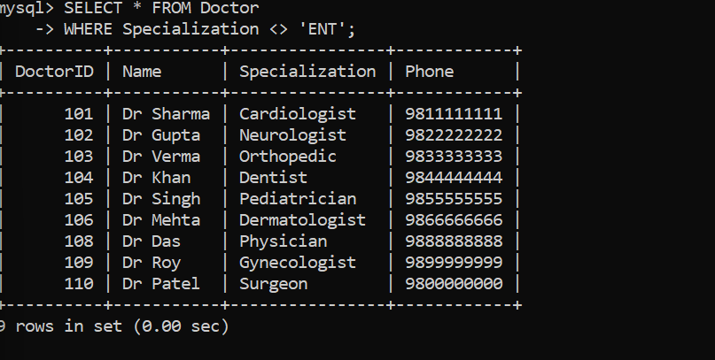

4.Write an SQL query to display doctors who are not ENT specialists.
Ans: SELECT * FROM Doctor WHERE Specialization <> 'ENT’;

Slide 38

5. Write an SQL query to display all patients sorted by age in descending order.
Ans: SELECT * FROM Patient ORDER BY Age DESC;

Slide 39
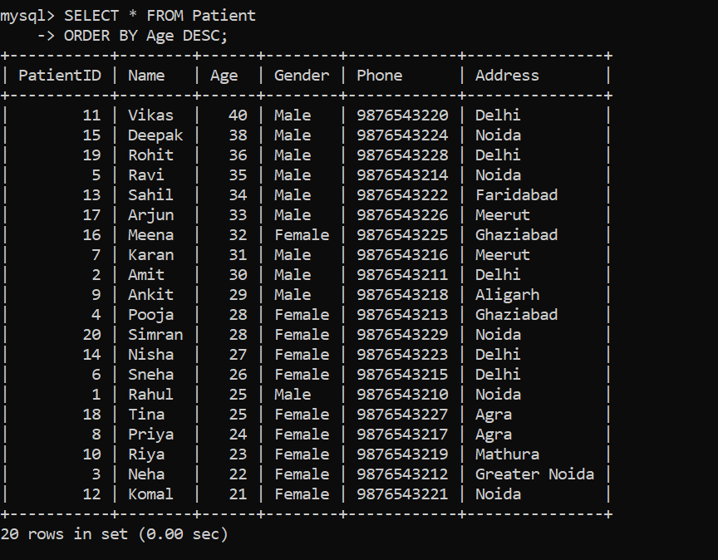

Slide 40
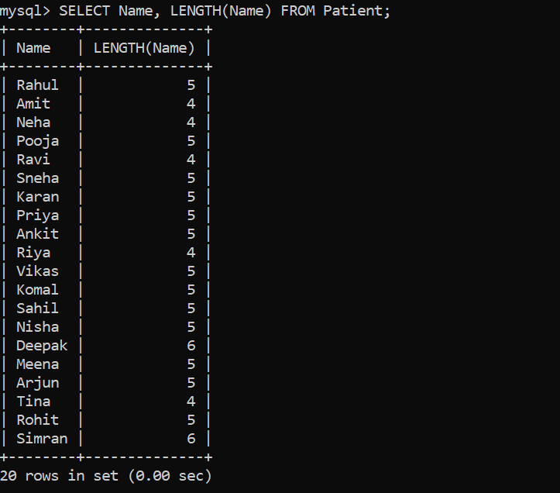
6.Write an SQL query to display length of each patient name?
Ans: SELECT Name, LENGTH(Name) FROM Patient;

Slide 41
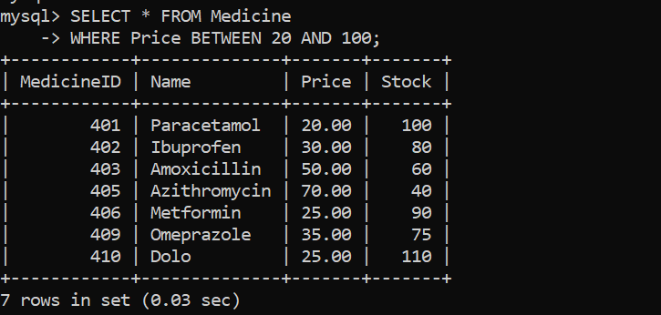

7.Write an SQL query to display medicines with price between 20 and 100.
Ans: SELECT * FROM Medicine WHERE Price BETWEEN 20 AND 100;

Slide 42
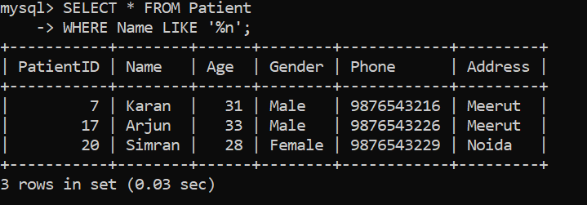

8.Write an SQL query to display patients whose names end with 'n’.
Ans: SELECT * FROM Patient WHERE Name LIKE '%n';

Slide 43
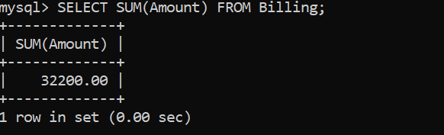

9.Write an SQL query to find total billing amount.
Ans: SELECT SUM(Amount) FROM Billing;

Slide 44

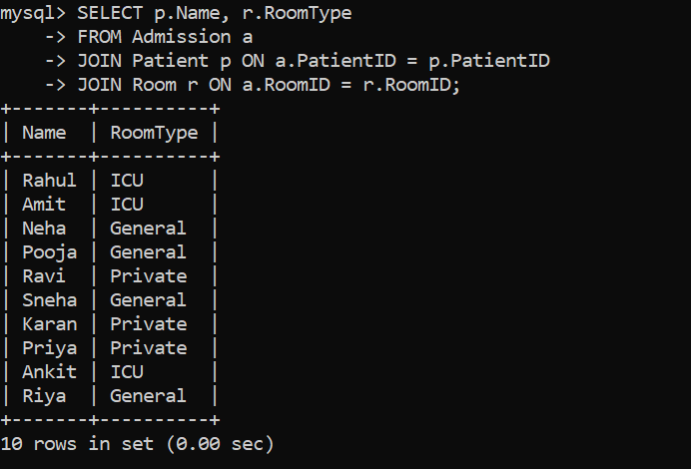
10.Write an SQL query to display patient name and room type.
Ans: SELECT p.Name, r.RoomType FROM Admission a JOIN Patient p ON a.PatientID = p.PatientID JOIN Room r ON a.RoomID = r.RoomID;

Slide 45
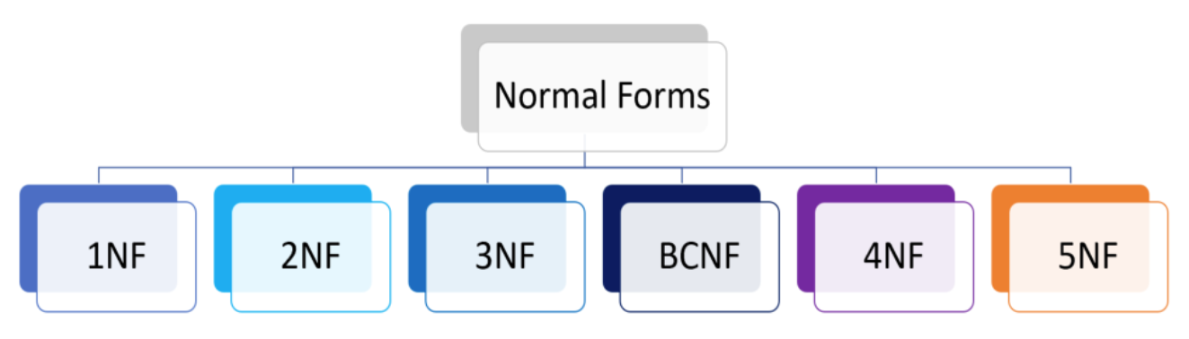
Normalization
Normalization is the process of organizing a database to reduce data redundancy and avoid anomalies.
It divides large tables into smaller related tables and arranges them into normal forms like 1NF, 2NF, 3NF, BCNF to maintain data integrity.

Slide 46
BEFORE NORMALIZATION TABLE
Table: Hospital_Dump
Patient_ID | Patient_Name | Doctor_Name | Specialization | Room_Type | Charges | Medicine | Quantity
1 | Rahul | Dr. Sharma | ENT | General | 1500 | Paracetamol | 2
1 | Rahul | Dr. Sharma | ENT | General | 1500 | Paracetamol | 3
2 | Amit | Dr. Verma | Cardiology | ICU | 5000 | Aspirin | 1
2 | Amit | Dr. Verma | Cardiology | ICU | 5000 | Aspirin | 2
3 | Priya | Dr. Singh | Orthopedic | Private | 3000 | Ibuprofen | 2
3 | Priya | Dr. Singh | Orthopedic | Private | 3000 | Ibuprofen | 1
4 | Neha | Dr. Sharma | ENT | General | 1500 | Cetrizine | 1
4 | Neha | Dr. Sharma | ENT | General | 1500 | Cetrizine | 2
5 | Rohan | Dr. Mehta | Neurology | ICU | 6000 | Neurobion | 1
5 | Rohan | Dr. Mehta | Neurology | ICU | 6000 | Neurobion | 2
6 | Simran | Dr. Verma | Cardiology | ICU | 5000 | Aspirin | 1
6 | Simran | Dr. Verma | Cardiology | ICU | 5000 | Aspirin | 3

Slide 47
FIRST NORMAL FORM (1NF)
1NF TABLES
Doctor
DoctorID | DoctorName | Specialization
101 | Dr. Sharma | ENT
102 | Dr. Verma | Cardiology
103 | Dr. Singh | Orthopedic
104 | Dr. Mehta | Neurology
Patient Table
PatientID | PatientName
1 | Rahul
2 | Amit
3 | Priya
4 | Neha
5 | Rohan
6 | Simran
Medicine
MedicineID | MedicineName
301 | Paracetamol
302 | Aspirin
303 | Ibuprofen
304 | Cetrizine
305 | Neurobion
Room
RoomID | RoomType | Charges
201 | General | 1500
202 | ICU | 5000
203 | Private | 3000

Slide 48
SECOND NORMAL FORM (2NF)
Appointment
Prescription
AppointmentID | PatientID | DoctorID | RoomID
401 | 1 | 101 | 201
402 | 2 | 102 | 202
403 | 3 | 103 | 203
404 | 4 | 101 | 201
405 | 5 | 104 | 202
406 | 6 | 102 | 202
PrescriptionID | AppointmentID | MedicineID | Quantity
501 | 401 | 301 | 2
502 | 401 | 301 | 3
503 | 402 | 302 | 1
504 | 403 | 303 | 2
505 | 404 | 304 | 1
506 | 405 | 305 | 2

Slide 49
THIRD NORMAL FORM (3NF)
PatientID | PatientName
1 | Rahul
2 | Amit
3 | Priya
4 | Neha
5 | Rohan
6 | Simran
DoctorID | DoctorName | Specialization
101 | Dr. Sharma | ENT
102 | Dr. Verma | Cardiology
103 | Dr. Singh | Orthopedic
104 | Dr. Mehta | Neurology
RoomID | RoomType | Charges
201 | General | 1500
202 | ICU | 5000
203 | Private | 3000

Slide 50
MedicineID | MedicineName
301 | Paracetamol
302 | Aspirin
303 | Ibuprofen
304 | Cetrizine
305 | Neurobion
AppointmentID | PatientID | DoctorID | RoomID
401 | 1 | 101 | 201
402 | 2 | 102 | 202
403 | 3 | 103 | 203
404 | 4 | 101 | 201
405 | 5 | 104 | 202
406 | 6 | 102 | 202
PrescriptionID | AppointmentID | MedicineID | Quantity
501 | 401 | 301 | 2
502 | 401 | 301 | 3
503 | 402 | 302 | 1
504 | 403 | 303 | 2
505 | 404 | 304 | 1
506 | 405 | 305 | 2

Slide 51
BOYCE-CODD NORMAL FORM (BCNF)
BCNF TABLE STRUCTURE
Doctor
DoctorID | DoctorName | Specialization
101 | Dr. Sharma | ENT
102 | Dr. Verma | Cardiology
103 | Dr. Singh | Orthopedic
104 | Dr. Mehta | Neurology
Specialization_room
Specialization | RoomID
ENT | 201
Cardiology | 202
Orthopedic | 203
Neurology | 202

Slide 52

Advantages
Saves time
Reduces errors
Easy data access
Better management
Cost effective
Improves decision making

Slide 53
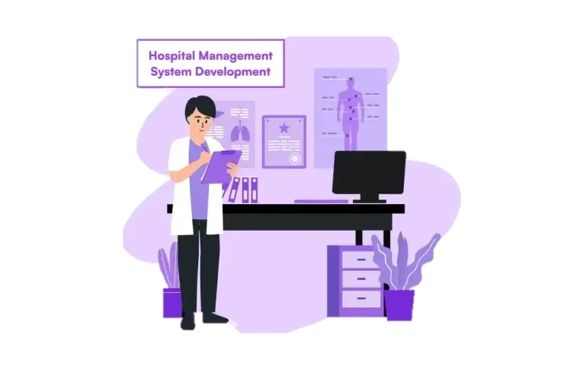
Conclusion
Hospital Management System improves efficiency
Helps in better decision making
Important for modern hospitals
Makes my project effective and practical

Slide 54

Future Scope
Add online appointment system
Mobile app integration
AI-based diagnosis
Online payment system
Cloud data storage
Telemedicine features

Slide 55

THANK YOU

